Slide 1
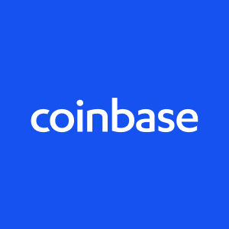
Coinbase
The Exchange of the Future

Slide 2
Overview
Who Are They ?
Online financial services company that provides digital currency for general transactions around the world
Founded
5/14/2012
Brian Armstrong, Fred Ehrsa, and Ben Reeves
Initial Funding
$5 million from Union Square
Idea
Digital currency can impact the world through: Innovation, efficiency, and equal opportunity
Notes:
Blockchain.info co-founder Ben Reeves. However, Reeves abandoned the company due to disagreements with Armstrong on how the Coinbase wallet should operate.

Slide 3
Business Activities
What Are They Trying To Solve?
Companies with great ideas never make it past the early stages of the business life cycle due to the high friction of payments
International payments are both slow and expensive
There are people who do not have access to a bank accounts
Core Technologies
Global Digital Asset Exchange
API for developers and merchants to build applications and accept payments in digital currencies
Notes:
The Coinbase founders recognized that many companies with great ideas never make it past the early stages of the business life cycle due to the high friction of payments. Coinbase hopes that in the future, a business forming in a remote village has the same opportunity as a hot Silicon Valley startup. International payments offer participants the worst of both worlds, being both slow and expensive. “Why does it take longer to wire money to Australia than to fly there? Why do U.S. bank transfers take 3 business days and not work on weekends? Why is there a 2–3% tax on almost every retail transaction in our economy (credit cards) when it is just moving bits from one data center to another?” Each country and payment company run their own proprietary system causing monopolies or oligopolies in each market. Coinbase believes the world’s payments should run on an open protocol. They believe this will lead to large efficiency improvements. Currently about 1/3 of the world lives on less than $2 per day, and about 90% of this population does not have access to a bank account. This leads to the smallest financial miscalculation or setback potentially being catastrophic for this population. Fortunately, nearly 100% of the developing world now has cellphones. The traditional banking model of earning interest on deposits does not work for people with a scarcity of money. Coinbase looks to bring financial services to the developing world, the only requirement being they must have a smart phone. Coinbase hopes to create an open financial system for the world by being the easiest place to buy and sell digital currency, and by creating impressive application prototypes. Coinbase’s original short-term goal was to make it as easy as possible for people to convert their local currency into and out of digital currency. This meant including as many countries and payment methods as possible, building relationships with regulators, and connecting to the traditional financial world. Once the infrastructure behind the digital currency matured, Coinbase looked towards adoption. Coinbase created an easy to use app that acted as the actual product that end consumers and businesses used. Currently Coinbase has two core products a Global Digital Asset Exchange (GDAX), used for trading a variety of digital assets on its trading platform. They also offer an API for developers and merchants to build applications and accept payments in digital currencies.

Slide 4
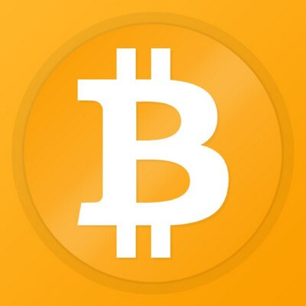
Landscape
Domains
Blockchain and Cryptocurrency domain
Trends
Regulation
Institutions entering market
Custodial services
ETF’s
ICO’s
Stable Coins
Competitors
Bitstamp, ItBit, and Bitfinex
Notes:
In 2018 the market fell from $830 billion to $100 billion dollars. This is largely a result of regulatory infrastructure not being ready. Regulators have begun and will continue watching the crypto space by creating a regulatory framework around it. Additional trends we have seen, and will continue to see include institutions entering the market. In 2019 Nasdaq and Boerse Stuttgart will start to offer crypto related products and trading platforms. Another trend is the development of Custodial Services, currently BlackRock, Goldman Sachs, and Coinbase are working on products that will allows institutions to have a safe environment to enter the crypto world. Crypto related Exchange traded products are something many companies have tried to offer, but no one has yet gotten approval for yet. We will continue to see a push for crypto ETF’s. The SEC has been going after companies that offered ICO’s and did not follow the established regulatory framework. The SEC has not been looking to stop ICO’s, but to make sure proper regulatory guidelines are followed. Establishment of stable coins. A stable coin is a coin that holds a stable value. The coin gets pegged to another stable asset such as the USD coin offered through Coinbase. This effectively eliminates volatility concerns that many consumers have.
Some of Coinbase’s top competitors include Bitstamp, who competes in the financial and commodity market field, and generates $551.9 million less revenue compared to Coinbase. ItBit who competes in the application software field and generates .7% the revenue of Coinbase. And Bitfinex competes in the transaction services field and generates 1.75% of Coinbase’s revenues. Coinbase has successfully proven that cryptocurrency users are not just a fringe part of the financial universe.

Slide 5
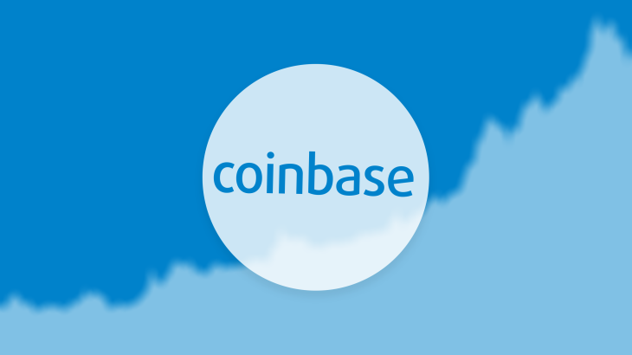
Results
Offer trading functionality in 32 countries
Crypto wallet is available in 190 countries
Partnerships
Bitlicense
DFS approval
Revenues
Notes:
Partnership with overstock
This marked a milestone in Bitcoin history as Overstock.com became the largest online retailer to accept digital currency as a form of payment.
Bitlicense - This allows Coinbase’s continuing virtual currency business operation in the state of New York. This acts as important validation for Coinbase to operate as the most secure and compliant digital currency exchange.
DFS approval 2017 Coinbase also became second company to receive DFS approval to offer trading of Ethereum and the first to offer Litecoin in New York.
Coinbase’s top competitors include Bitstamp, who competes in the financial and commodity market field, and generates $551.9 million less revenue compared to Coinbase. ItBit who competes in the application software field and generates .7% the revenue of Coinbase. And Bitfinex competes in the transaction services field and generates 1.75% of Coinbase’s revenues.

Slide 6
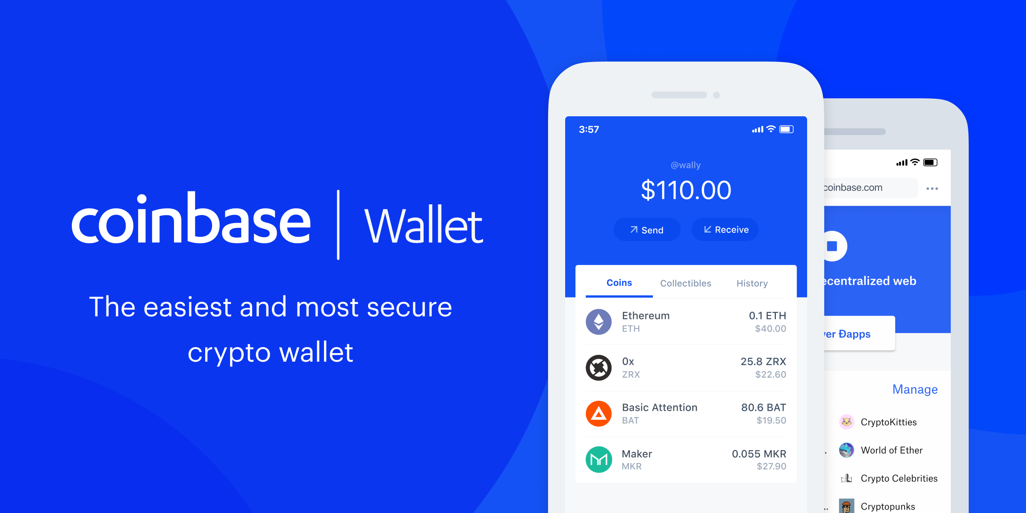
Recommendations
Products
Exchange
Wallet
USD coin
Earn
Pro
Commerce
Custody
Ventures
Recommendation
Coinbase should offer trading services in additional countries
Notes:
Coinbase currently offers consumers an exchange where users can buy and sell digital currencies, a wallet for users to store their digital currencies, USD coin (a way of moving USD globally), Earn (a program where you are given crypto for learning about crypto), and Pro (advanced cryptocurrency trading). They offer businesses commerce (crypto payment service), custody (crypto custody for institutions) and ventures (a way to raise money for a crypto startup). I believe Coinbase is currently doing a great job with their product offerings. However, I stated earlier that Coinbase offers trading functionality in 32 countries. I recommend Coinbase make a strong push to service additional countries. Coinbase has stated that they are trying to operate in 168 countries. However, after being valued at over $1 billion dollars and recently receiving over 100 million in funding this has not yet happened. Digital currencies are known for being borderless and decentralized in nature, it seems contradictory that there would be restrictions as to where you can trade these currencies.

